Slide 1
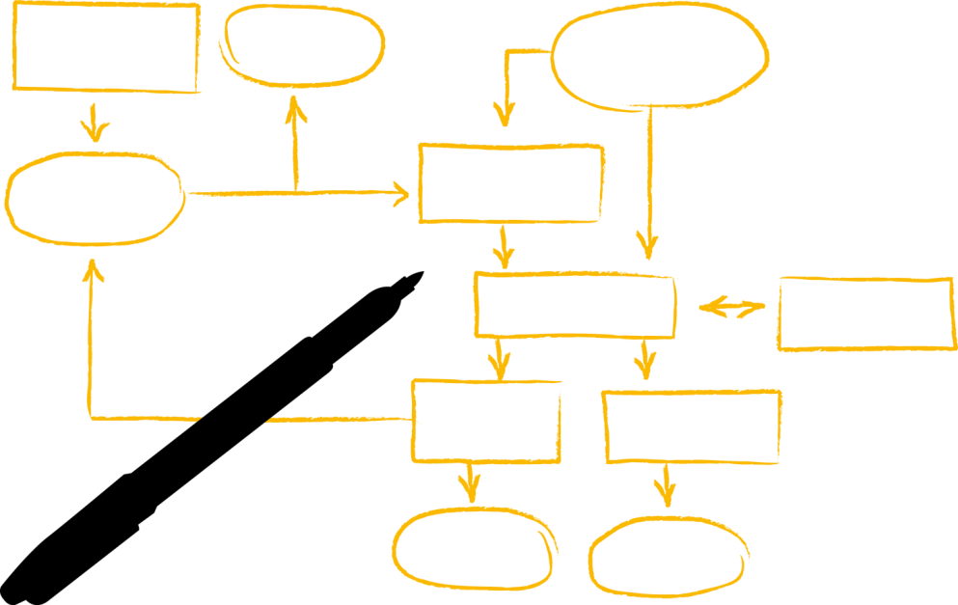
Introduction to Machine Learning for S/4HANA
Internal
Santosh Kumar Addanki
S/4HANA Architecture and Enablement, Palo Alto October, 2017

Slide 2
Introduction to Machine Learning (3-Day Training)
This 3-day training is for everyone interested in acquiring a good understanding of machine learning principles. We will cover the most important machine learning algorithms for supervised and unsupervised learning (including linear regression and multinomial logistic regression, decision trees and random forest (for both classification and prediction), support vector machines, k-means and hierarchical clustering as well as principle component analysis. (Additional algorithms may be covered if time permits.) Every algorithm will be explained in detail and participants should be able (at least in principle) to implement some of the algorithms on their own.
We will utilize Jupyter notebooks and the very popular Python-based Scikit-Learn for exercises and data visualization. Scikit-Learn provides a consistent framework for building end-to-end machine learning pipelines including various tools to evaluate the trained models. It is also supported by Leonardo ML.
After having gained a solid background in machine learning, we will contrast Scikit-Learn with HANA’s Predictive Analysis Library (PAL) and SAP Predictive Analysis.

Slide 3
Scalable Machine Learning (1-Day Training) Introduction to TensorFlow (1-Day Training)
Scalable Machine Learning and Introduction to Neural Networks
Many recent improvements in ML are attributed to the availability of large datasets and powerful distributed compute environments. Course participants will learn how to combine corporate data (stored in HANA) with large, public datasets (stored in Hadoop), and how to utilize the parallel machine learning algorithms that are available in Apache Spark ML and TensorFlow to train machine learning models in a Kubernetes-based compute cluster. The trained models can be applied from virtually any application either by submitting a job to a Spark cluster or via TensorFlow’s high-performance serving system.
Introduction to TensorFlow
Learn how to use TensorFlow to build simple classifiers (hands-on exercises). We will also cover (without exercises) how to use convolutional and recurrent neural networks to solve problems such as image recognition, text understanding, and time series forecasting. In addition to training machine learning models from scratch, we will describe so-called transfer learning which allows us to utilize complex pre-trained models as a starting point for training models in a much shorter period of time.

Slide 4
Agenda: Day 1
Introduction to Machine Learning and Machine Learning Concepts :
What is machine learning?
High-level classification of ML algorithms: Supervised learning, Unsupervised Learning, Reinforcement Learning (not covered in detail)
Machine Learning Principles
Overview of the training environment (Jupyter Notebooks) and Just Enough Python/NumPy (Hands-On)
Regression
Linear Regression
Algorithm
Stochastic Gradient Descent
Regularization: None, L1, L2
Multi-Variate Linear Regression
Gradient Descent for multiple variables
Features and Polynomial Regression

Slide 5
Agenda: Day 2
Classification
(Binomial) Logistic Regression
Cost Function
Gradient Descent
Multinomial Logistic Regression
Decision Trees
Ensemble Methods (not specific to decision trees)
Random Forest
Boosting/Bagging
Gradient-boosted Trees

Slide 6
Agenda: Day 3
Support Vector Machines (SVM)
Optimization Intuition
Large Margin Intuition
Kernels
Unsupervised Learning
K-Means Clustering
Hierarchical Clustering
Dimensionality Reduction: Principle Component Analysis (PCA)
Discussion: End-to-end ML pipeline at SAP

Slide 7
Agenda: Day 4
Scalable Machine Learning
Introduction to PySpark and Spark ML
Data Preparation
Data Pipelines in Spark
TensorFlow
Introduction to Neural Networks and Deep Learning
Introduction to Deep Learning
Logistic Regression as a Neural Network
Shallow Neural Network
Deep Neural Networks
Backpropagation
Hands-on: Implement a neural network from scratch

Slide 8
Agenda: Day 5
Introduction to TensorFlow
Basic Concepts: Graphs / Sessions
Hands-on: Simple Classification
Tensor Board
TensorFlow Serving
Convolutional NN
Recurrent NN
HANA and TensorFlow

Slide 9
What is Machine Learning?

Slide 10
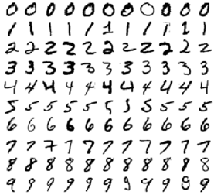
What is Machine Learning?
How would you write a program that can recognize digits?

Slide 11

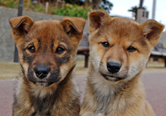
What is Machine Learning?
How would you write a program that can recognize digits?
How would you write a program that can distinguish between cats and dogs?

Slide 12
What is Machine Learning?
How would you write a program that can recognize digits?
How would you write a program that can distinguish between cats and dogs?
[Machine Learning is the] field of study that gives computers the ability to learn without being explicitly programmed. Arthur Samuel, 1959

Slide 13
What is Machine Learning?
"Programming computers to learn from experience should eventually eliminate the need for much of this detailed programming effort“
Samuel, A. L. (1959), “Some Studies in Machine Learning Using the Game of Checkers” in IBM Journal of Research and Development (Volume:3, Issue: 3), p. 210

Slide 14
Our Training Environment
There are several (excellent) ML trainings available to SAP employees that show how to invoke a particular ML algorithm in Predictive Analysis (expert and automated mode), PAL, R, Python, and Excel.
We will focus instead on Python, Scikit-Learn, and TensorFlow.
Python has recently bypassed R as the most popular programming language for machine learning.
Scikit-Learn is a well-designed, very easy to use and extremely popular library for ML.
TensorFlow is a more low-level library for developing and serving machine learning algorithms (though more and more high-level components have been added (Keras, scikit-learn inspired predictors, etc.) TensorFlow is very fast and scalable. Moreover, it provides a lot of features that make the design and evaluation of machine learning models much easier.

Slide 15
Why Python, Scikit-Learn, and TensorFlow?
By focusing on Python, Scikit-Learn, and TensorFlow, we
Utilize the same tools that are used in academia and industry (and benefit directly from open-source contributions)
Maintain complete flexibility
Are completely aligned with Leonardo ML, which is critical for the productive use of ML models from within our applications (more on this later)
Finally, our goal is not so much to cover as many algorithms as possible, but to get a deeper understanding of how some of the most popular algorithms work and – more importantly – how they are related to each other. In other words, by the end of the week, you should have a solid understanding of the most important ML concepts.
Please note: If PAI and PAL meet your requirements (this is typically the case if your datasets are small and/or reside in HANA), please use them! In fact, this training should make it easier to evaluate and use the capabilities of our own tools.

Slide 16
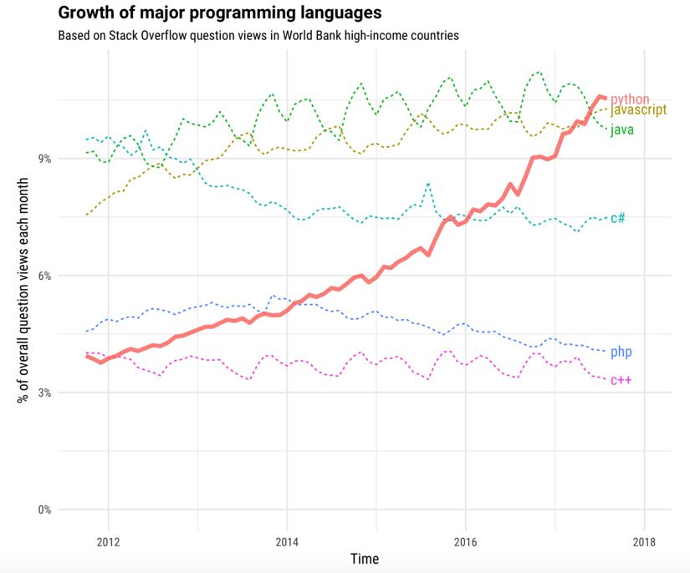
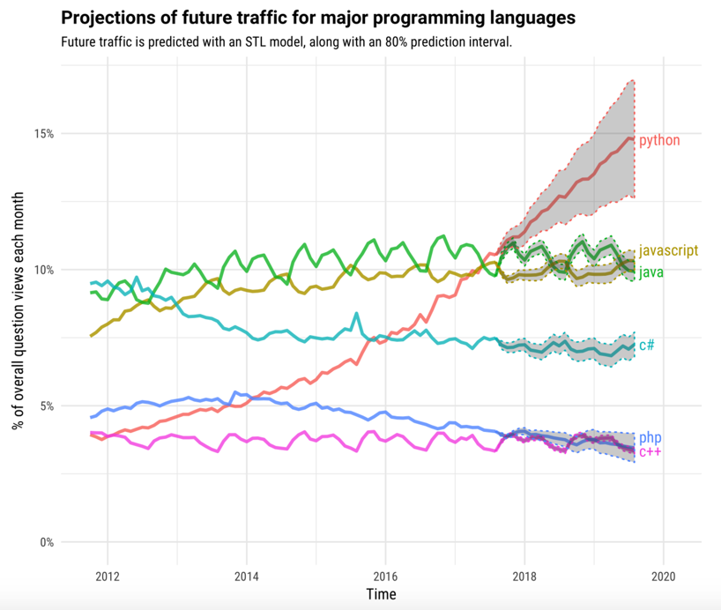
The Incredible Growth of Python
https://stackoverflow.blog/2017/09/06/incredible-growth-python/

Slide 17
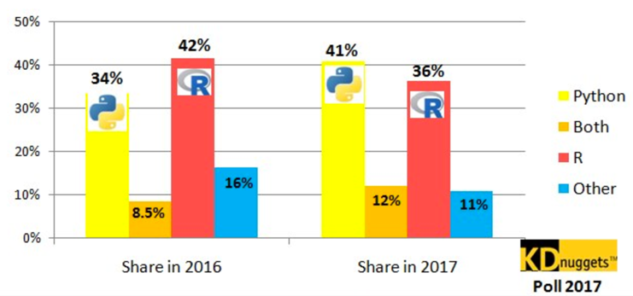
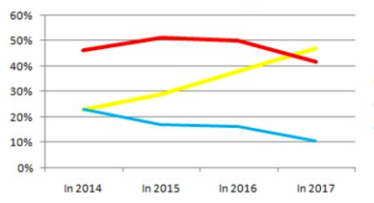
Python, R for Analytics, Data Science and Machine Learning
http://www.kdnuggets.com/2017/08/python-overtakes-r-leader-analytics-data-science.html

Slide 18
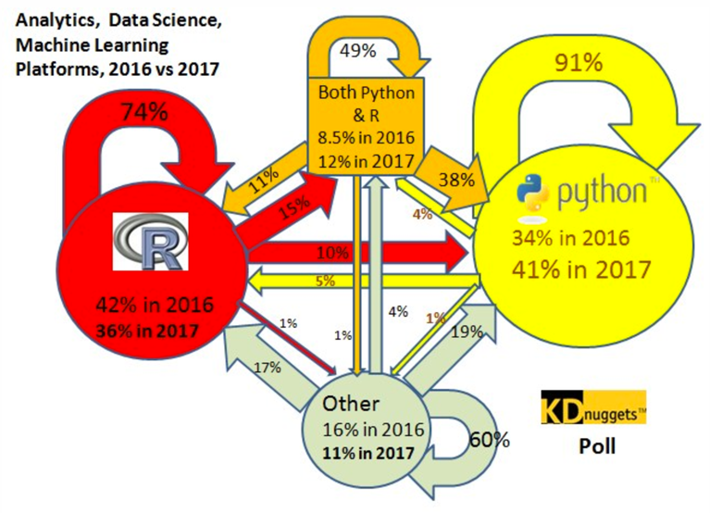
Python, R for Analytics, Data Science and Machine Learning
http://www.kdnuggets.com/2017/08/python-overtakes-r-leader-analytics-data-science.html

Slide 19
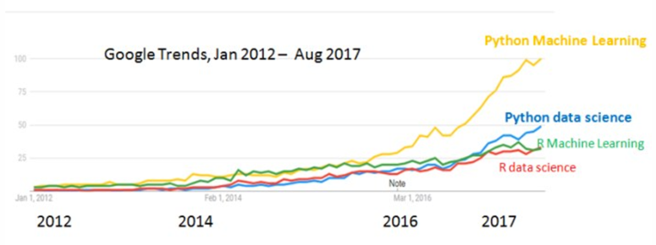
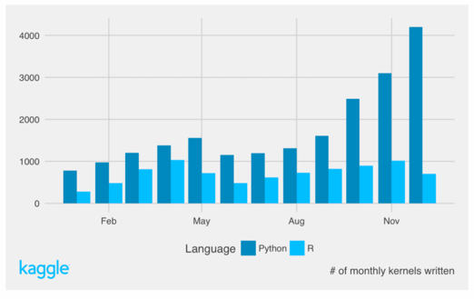
Python, R for Machine Learning vs. Data Science
http://www.kdnuggets.com/2017/09/python-vs-r-data-science-machine-learning.html

Slide 20
Why Scitkit Learn?
Scikit-Learn is extremely well designed, and even inspired the design of other machine learning tools, such as Apache Spark’s pipelines (see next slide) or the high-level estimators in TensorFlow).
All algorithms in Scikit-Learn have a consistent interface
All hyper parameters as well as the learned parameters of the estimators are accessible
The building blocks (transformers, estimators, and predictors) are composable into machine learning pipelines
The estimators have sensible defaults (and work out-of-the-box)
The datasets are all based on NumPy arrays or SciPy’s sparse matrices

Slide 21
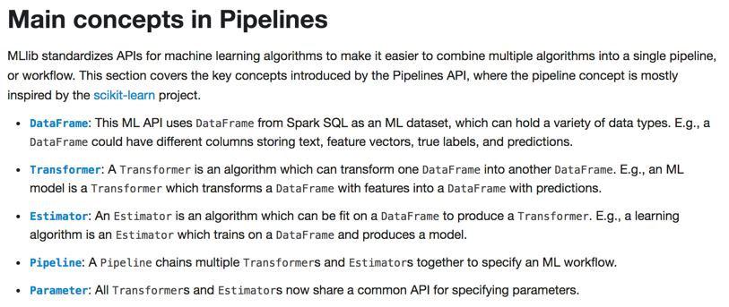

Spark Pipelines (inspired by scikit-learn)

Slide 22
Scitkit-Learn: Estimators
Supervised Learning
model.fit(X, y) # Fit training data; X = data, y = labels
model.predict(X_new) # Returns predicted labels
model.predict_proba(X_new) # Only available for some classifiers: Returns probability of each label
model.score() # Number between 0 and 1; larger number => better fit
Unsupervised Learning
model.fit(X) # Fit training data
model.transform(X_new) # Transform new data
model.fit_transform(X) # Efficiently perform a fit and transform of input data, not available for all estimators

Slide 23
When not to use Scikit-Learn?
Scikit-learn is easy to use and has sophisticated algorithms that work with medium-sized data. What if you want to build a classifier with thousands of features and millions of training examples? You may have to train your algorithm in a distributed compute environment (potentially co-located with Apache Spark).
While most scikit-learn algorithms can be tuned via hyper parameters, sometimes it is necessary to design your own algorithm from basic components (not from scratch).
You might need better tools to analyze your algorithm (both during the training as well as the serving of the model).

Slide 24
TensorFlow
TensorFlow has been developed by Google and was open sourced in 2015. The main focus is the design, building, training and serving of deep neural networks, though it can be used for the development of pretty much any machine learning algorithm.
The main concept behind TF is a dataflow graph, where nodes represent operations, and data (in form of multi-dimensional arrays – so-called tensors) flows through the edges. There is a clear separation between the creation of the graph and the (efficient) execution of the graph.
(The concept is very similar to calculation scenarios in HANA, or even the so-called logical plans in Apache Spark. )
TensorFlow supports the efficient processing of data flow graphs in a distributed environment, a great tool for monitoring (TensorBoard). It also calculates the gradients for backpropagation automatically, which makes the development of deep neural networks much easier.

Slide 25
Questions?

Slide 26
Main Categories of Machine Learning
Supervised Learning:
The training data contains the desired predicted or classified values (so-called labels).
Unsupervised Learning:
The training data does not contain any labels. The system tries to learn without any guidance.
Semi-Supervised Learning:
A combination of supervised and unsupervised learning. Some labels are provided.
Reinforcement Learning:
The system (“agent”) learns the best strategy (“policy”) that maximizes a reward function by observing the environment and selecting and performing actions.

Slide 27
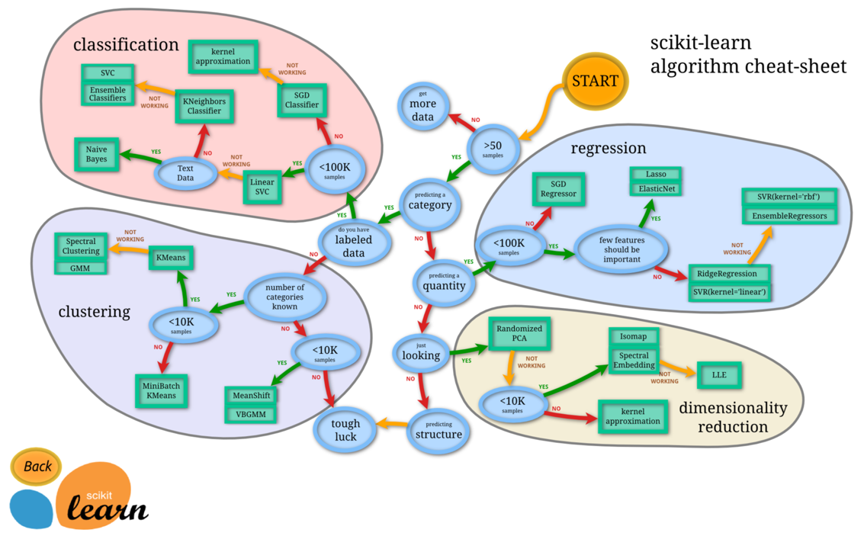
How to select the right algorithm? (The cheat sheet below may not be of much use.)

Slide 28
A Classification of Some ML Algorithms
Machine Learning
Supervised Learning
Unsupervised
Learning
Regression
Cluster Analysis
Dimensionality Reduction
Classification
SVM
Decision Trees
Linear Regression
Hierarchical Clustering
PCA
t-SNE
K-Means
KNN
Logistic Regression

Slide 29
A Classification of Some ML Algorithms
Machine Learning
Supervised Learning
Unsupervised
Learning
Cluster Analysis
Dimensionality Reduction
Anomaly
Detection
Classification
Regression
Ranking
SVM
Decision Trees
Linear Regression
Hierarchical Clustering
PCA
t-SNE
K-Means
KNN
Logistic Regression

Slide 30
Machine Learning Concepts
Before looking at individual algorithms, let’s have a look at some high-level machine learning concepts. We start with just a few and will add more throughout the training. We will explore the concepts in detail during the exercises.

Slide 31
Supervised Machine Learning
Training Data
Model
Training
Training Labels
Test Data
Prediction
Generalization
Test Labels
Evaluation

Slide 32
Machine Learning Concepts: Generalization (Supervised Learning)
Learning =?= Generalization
A system is trained on (labeled) training data, and evaluated on (labeled) test data.
If a system does not perform well on the training data, then the algorithm has a high bias and is underfitting the data. A system that performs well on the training data, but not on the test data failed to generalize what it learned. Such an algorithm has a high variance and is overfitting the data.
There is generally a tradeoff between bias and variance (at least for the classical machine learning algorithms).
Overfitting may be reduced by choosing an algorithm that has a lower variance, by increasing the training set, or by regularization. The latter will be discussed when we explore specific ML algorithms.

Slide 33
Machine Learning Concepts: Dimensionality Reduction (Unsupervised Learning)
Learning =?= Dimensionality/Feature Reduction
While supervised systems learn from labeled instances and need to generalize to predict/classify unseen data, unsupervised systems often ”learn” by summarizing the data or by transforming the data to a lower dimension.
Examples:
Principle Component Analysis (PCA): Reduce the number of dimensions by eliminating those that have the lowest variance. In other words, the data is projected to a lower-dimensional subspace. Example use-case: Image compression.
Clustering: By labeling individual examples, we “reduce” the examples to the properties of the cluster they are assigned to. Business example: customer segmentation, i.e. we devise an identical strategy for every customer belonging to the same segment.

Slide 34
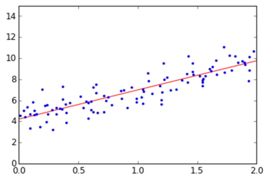
Similarities between Generalization and Dimensionality Reduction
Example: Linear Regression
Linear regression can be interpreted as projecting the data set to a lower dimension. In the diagram, we reduce the dimension from 2 to 1 by projecting the points in the plane to a line.

Slide 35
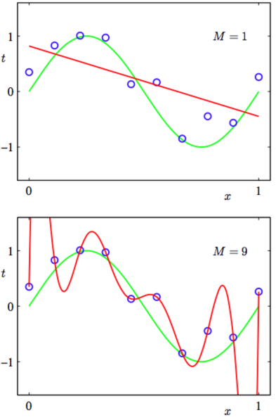
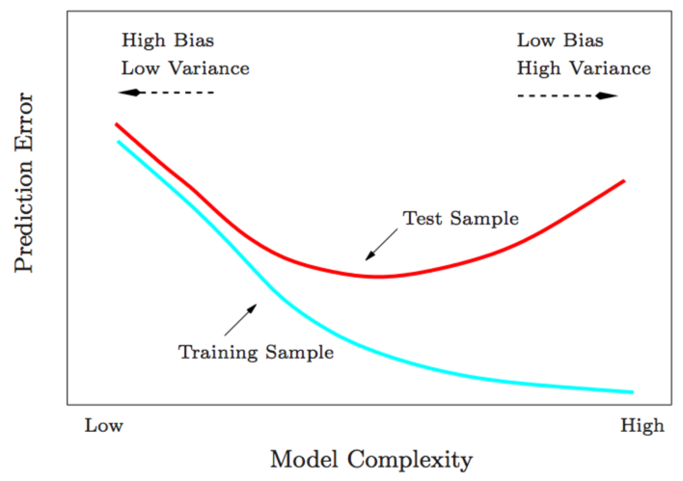
Bias and Variance

Slide 36
Decision Trees

Slide 37
Decision Trees (CART)
Intuitive: Easy to understand and interpret
Minimal data preparation:
Since only one feature is considered at a time, normalization is not required
Performance (Prediction) is logarithmic in the number of data points used to train the tree
Can handle both numerical and categorical data
White box model, i.e. data is easy to interpret
Possible to validate a model using statistical tests

Slide 38
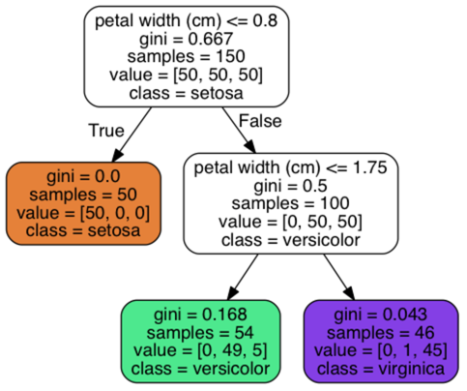
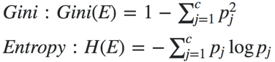
Decision Trees (CART)
Binary Tree
Internal Nodes: Question on a single feature, such as “petal length <= 2”
Leaf Nodes: Contains class label, determined by majority vote of training examples reaching the leaf
Samples: The number of training examples the node represents
Value: Distribution of training examples by class
Class: Determined by majority vote
Impurity measure: Gini or Entropy
Here we are using Gini
Value 0: All training examples belong to the same class
Example, bottom-left node:
Distribution: [0, 49, 5], Samples: 54 -> Gini = 1 – (0/54)^2 – (49/54)^2 – (5/54)^2 = 0.168

Slide 39
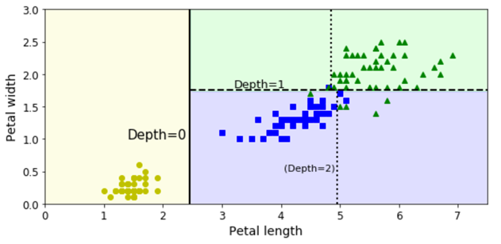
Decision Tree Boundaries
Vertical Line: Decision Boundary of root node: petal length = 2.45
Left area is pure (Gini=0, all examples are of type setosa, so no further splits
Right area, horizontal line: petal width = 1.75, further splits needed (Gini = 0.5)
(max_depth = 2)

Slide 40
“Growing the tree” – CART Algorithm
Idea: Split training set into two subsets using a single feature k and a threshold t_{k} (e.g. k = petal width, t_{k} = 1.75)
Choice of k, t_{k}: Find the pair (k, t_{k}) that produces the purest subsets (based on Gini impurity or Entropy)
Cost Function: J(k, t_{k}) = (m_{left} / m) * G_{left} + (m_{right} / m) * G_{right}
G_{left/right}: Impurity of the left/right subset
m_{left/right}: Number of instances in the left/right subset
The algorithm splits the subsets recursively using the same logic until the maximum depth is reached (max_depth hyperparameter),
or it cannot find a split that reduces impurity.
Differences between Gini impurity and Maximum Entropy
Both lead to very similar results, ME is slightly slower
Gini tends to isolate the most frequent class in its own branch
ME may lead to slightly more balanced trees

Slide 41
Disadvantages of Decision Trees
Overfitting: The trees can be very complex and do not generalize the data well.
Small variations in the data might result in a completely different tree being generated.
The learning of an optimal decision tree is NP-complete, so heuristic algorithms (e.g. greedy algorithm) is used. An optimal decision is made at each node, but a globally optimal decision tree cannot be guaranteed.
Since a split is only based on one feature at a time, certain functions (e.g. XOR) cannot be expressed easily

Slide 42
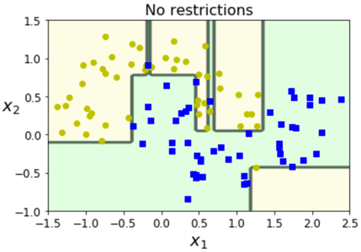
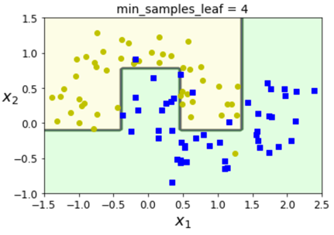
Regularization Hyperparameters
A decision tree model is nonparametric, so it is free to fit the training data very closely which often leads to overfitting.
To avoid overfitting, we often have to restrict (regularize) the model (i.e. increase the bias)
max_depth (maximum depth of the tree)
min_samples_split (minimum number of samples a node must have before it can split)
min_samples_leave (minimum number of samples a leave node must have)
max_leave_nodes (maximum number of leave nodes)
…
The model is regularized by increasing the min_xxx parameters and decreasing the max_xxx parameters.

Slide 43
Ensemble Methods

Slide 44
Ensemble Methods
An ensemble method often provides good results (“strong learner”) even if the individual classifiers perform just slightly better than random guessing (“weak learner”) – provided that
there are a sufficient number of weak learners and
the weak learners are diverse (ideally, the should be independent of each other)
Hard-Voting Classifier
Train several classifiers
Aggregate the predictions of each classifier and predict the class that gets the most votes
Soft-Voting Classifier
Train several classifiers that can provide a class probability
Predict the class with the highest class probability averaged over all the individual classifiers

Slide 45
Bagging and Pasting / Random Features and Subspaces
Instead of using different algorithms, train the same algorithm on different random subsets of the training set.
Bagging (Bootstrap Aggregation): Sampling is performed with replacement
Pasting (less common): Sampling is performed without replacement
Bagging allows training instances to be sampled several times for the same predictor.
An ensemble method based on bagging has a similar bias as a classifier trained on the entire dataset, but its variance is lower.
Out-of-Bag Evaluation: Since not all training instances are sampled for each predictor, the remain ones (so-called out-of-bag instance) can be used for validation. This eliminates the need for keeping a separate validation set or using cross-validation.
Random Features: Sample the features of the datasets in addition to the training instances.
Random Subspaces: Sample the features, but use all training instances.

Slide 46
Random Forest
A random forest is an ensemble of decision trees and utilizes
Bagging (bootstrap aggregation)
A random subset of features (typically √p for classification; n/3 (but not fewer than 5) for regression)
Train all trees independently of each other.
The final prediction is obtained by majority voting (in case of classification)
or by averaging the predictions (in case of regression).

Slide 47
Random Forest / Extra-Trees
All regularization parameters that are available for decision trees apply (though they tend to be applied more aggressively).
Since individual trees are based on different random subsets, the nodes are split differently (both on different features and thresholds). Thus, the individual classifiers are more diverse, and the ensemble has a lower variance.
Random forest does not perform well if the features are dependent of each other or if you have more features than samples. If this is the case (or if you are not sure), reduce the number of features by applying PCA.
Extra-Trees: Instead of selecting the best threshold, use random thresholds in order to make the individual trees even more diverse. The is called extremely randomized trees (or “extra-trees”).

Slide 48
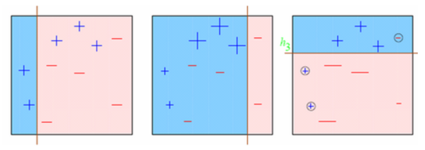
Boosting
Like bagging, boosting is an ensemble method that combines several (weak) learners.
Instead of using majority voting, the (weak) learners are combined in sequence, where (typically) each subsequent classifier is trying to correct the mistakes of its predecessor.
AdaBoost: The weights of the previously misclassified training instances are increased, so the subsequent classifier can focus more on the hard cases.
(For a very gentle introduction, see https://www.youtube.com/watch?v=gmok1h8wG-Q )

Slide 49
Gradient Boosted Decision Trees
Instead of increasing the weights of previously misclassified samples after each iteration, the subsequent classifier/regressor tries to predict the residual errors of its predecessor.
Example:
from sklearn.tree import DecisionTreeRegressor
tree1 = DecisionTreeRegressor(max_depth=2)
tree1.fit(X, y) #Train first decision tree
y2 = y – tree1.predict(X)
tree2 = DecisionTreeRegressor(max_depth=2)
tree2.fit(X, y2) # Train the second decision tree on the residual error of the first predictor
y3 = y2 – tree2.predict(X)
tree3 = DecisionTreeRegressor(max_depth=2)
tree3.fit(X, y3) # Train the third decision tree on the residual error of the second predictor
y_hat = sum(tree.predict(X_Test) for tree in (tree1, tree2, tree3)
Or simpler:
from sklearn.ensemble import GradientBoostingRegressor
gboost = GradientBoostingRegressor(max_depth=2, n_estimators=3, learning_rate=1.0)
gboost.fit(X, y)

Slide 50
Gradient Boosted Decision Trees
Unlike random forest (which requires very little tuning), GBDTs are prone to overfitting and require the careful tuning of various hyperparameters.
Since every new tree corrects the residual errors of its predecessor, the model can very quickly end up overfitting the training set.
The learning can be slowed down by applying a weighting factor to the subsequently added trees. The weighting factor is controlled by the learning rate (also called shrinkage factor).
Values less than 1.0 lead to fewer corrections of each newly added tree. As a consequence, more trees need to be added. Good values may be in the range of 0.1 – 0.3, sometimes even below 0.1.

Slide 51
XGBoost
Tip:
While scikit-learn supports gradient boosted decision trees, there is one implementation (with a Python and R API) that performs much better. It’s called XGBoost
http://xgboost.readthedocs.io/en/latest/
So if you plan to win Kaggle competitions, make sure you have XGBoost in your toolbox. (Also, be prepared to spend a lot of time on parameter tuning.)
http://blog.kaggle.com/2017/01/23/a-kaggle-master-explains-gradient-boosting/

Slide 52
Unsupervised Learning - Clustering

Slide 53
Unsupervised Learning - K-Means Clustering
Separate (unlabeled) samples into k groups by trying to minimize within-cluster sum-of-squares
Number of clusters need to be specified
Each group is defined my the mean of the samples in the cluster
The mean of a cluster is called a centroid.
Obviously, a centroid is (most probably) not a point of the original dataset. If this is required, there is a variation of k-means, called k-medoids which always selects centroids from the original dataset.
Another variation of k-means is k-medians, which uses the median as a centroid, i.e. the error is minimized according to the 1-norm distance metric instead of the square of the 2-norm distance metric

Slide 54
Cluster Analysis – Partitioning Algorithms
Distance-based method:
Partitioning algorithms: K-Means, K-Medians, K-Medoids
Distance between two data objects
Rules:
A cluster is a collection of data objects that are:
High intra-class similarity: Similar to one another within the same cluster.
Low inter-class similarity: Dissimilar to the objects in other groups, i.e. clusters.
Weights
Heights

Slide 55
K-means Algorithm
Step 0: (Initialization)
Randomly select k centroids (generate or select from dataset)
Step 1: (Assignment)
Each sample is assigned to the its closest centroid (based on the Euclidean distance)
Step 2: (Update of Centroids)
For each cluster (= samples assigned to the same centroid), the centroid becomes the mean of the samples
Iterate between steps 1 and 2 until a stopping criterion is reached, e.g.
Maximum number of iterations is reached
Samples are no longer reassigned to different clusters

Slide 56
K-means Algorithm
The k-means algorithm is guaranteed to converge. However, since the initial centroids where chosen randomly, the result is often a local minimum
Consequently, the algorithm is run several times (with different initializations of the centroids)
To determine the optimal number of k, the algorithm is run for a range of k values
The is no obvious best choice for k. By increasing k, the within-cluster some of square is decreasing (and eventually reaches zero)

Slide 57
Evaluating the Quality of the Result
Silhouette Coefficient:
Checks cluster cohesion and separation together.
K = 3
$$dist\left(a,OthersC\right)= distance of \text{a} from data objects of other cluster$$
Weights
a
c3
$$μ=mean$$
$$dist\left(a,SameC\right)= distance of \text{a} from data objects of same cluster$$
min: minimum
max: maximum
c2
c1
Silhouette Coefficient for a, =
a
$$\frac{min⁡(μ\left(dist\left(a,OthersC\right)\right))−μ(dist\left(a,SameC\right))}{max⁡(\min\left(μ\left(dist\left(a,OthersC\right)\right)\right),μ(dist\left(a,SameC\right)))}$$
Heights

Slide 58
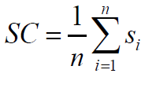
Cluster Analysis – Partitioning Algorithms – K Means
Silhouette Coefficient:
Checks cluster cohesion and separation together.
K = 3
Weights
c3
c1
c2
SC is complete Silhouette Coefficient
is Silhouette Coefficient of ith data object
n is total number of data objects
SC close to one 1 implies good clustering.
Heights

Slide 59
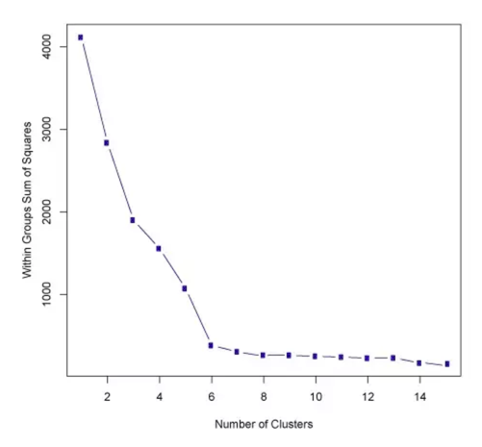
Elbow Method

Slide 60
K-Means++
Since the initialization has a major impact on the quality of the result (local vs. global minimum), an improved algorithm, K-means++ should be used. (Scikit-learn is using k-means++ by default; init='k-means++’).
See k-means++ Wikipedia entry (and references) for more details:
K-means++ Initialization
Choose one center uniformly at random from among the data points.
For each data point x, compute D(x), the distance between x and the nearest center that has already been chosen.
Choose one new data point at random as a new center, using a weighted probability distribution where a point x is chosen with probability proportional to D(x)².
Repeat Steps 2 and 3 until k centers have been chosen.
Now that the initial centers have been chosen, proceed using standard k-means clustering

Slide 61
K-means – Other Considerations
Data normalization is key to getting sensible results!
Understand the data before running k-means: K-means is pretty useless is the clusters are elongated, manifolds with irregular shapes, etc.
Use a parallel algorithm. Also, distributed compute environmens (e.g. Apache Spark) make it very easy to run multiple parallel instances of k-means (for different k’s and initializations)
K-means could be useful to enhance classification tasks (at least for samples where convex clusters can be assumed to exist)
Consider PCA to reduce dimensionality!
http://scikit-learn.org/stable/auto_examples/cluster/plot_kmeans_digits.html

Slide 62
Hierarchical Clustering
Divisive
Top-down, i.e. start with all samples in one cluster, then divide the cluster recursively (k-means with k = 2?)
O(2^{n})
Agglomerative
Every sample is in its own cluster. Clusters are subsequently combined until all clusters are merged
O(n²log(n))
In addition to defining a measure to compare the similarity between instances, we need to decide how ”close” the cluster are to each other. This is called “linkage”.
Maximum (Complete Linkage): Maximum distance between any two samples from each cluster
Minimum (Single Linkage)
Mean, ..

Slide 63
Dimensionality Reduction - PCA
Machine Learning
Supervised Learning
Unsupervised
Learning
Regression
Cluster Analysis
Dimensionality Reduction
Classification
SVM
Decision Trees
Linear Regression
Hierarchical Clustering
PCA
t-SNE
K-Means
KNN
Logistic Regression

Slide 64
Dimensionality Reduction – Principle Component Analysis (PCA)
PCA is a technique for dimensionality reduction
Apply linear transformations to project data to a lower dimensional subspace without “losing too much information”
PCA returns the directions (principal components) that maximize the variance of the data
Approach:
Standardize the data (all features should have a mean (μ) of zero and standard deviation (σ) of 1)
Calculate eigenvectors and eigenvalues from covariance matrix, correlation matrix, or singular value decomposition (SVD)
Sort the eigenvectors according to their eigenvalues in descending order
Create a projection matrix W by selecting the the first k eigenvectors (k <= d)
Use W to transform the original dataset X to a k dimensional subspace

Slide 65
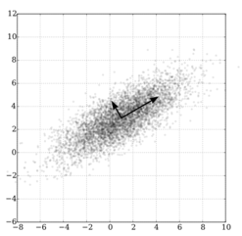
PCA – Intuition
Use an orthogonal transformation to convert a dataset of possibly correlated features into a set of linearly uncorrelated features, so-called principle components.
Number of principle components: Less or equal to the number of features in the original dataset
The transformation ensures that the first principle component has the largest variance
Each succeeding component in turn has the highest variability under the condition that it is orthogonal to the preceding components
The resulting vectors constitute an uncorrelated orthogonal basis set

Slide 66
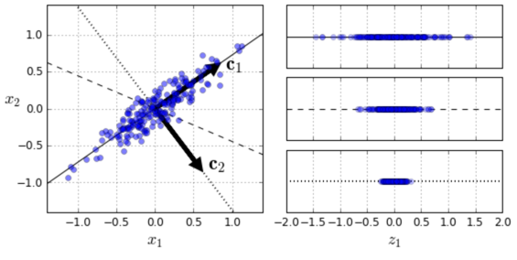
PCA – Intuition

Slide 67
PCA – Via Singular Value Decomposition
X_centered = X – X.mean(axis=0)
U, s, V = np.linalg.svd(X_centered)
c1 = V.T[:, 0]
c1 = V.T[:, 0]
…

Slide 68
Introduction to TensorFlow

Slide 69
What isTensorFlow?
Open Source library developed by Google Brain Team
Created for tasks requiring heavy numerical computations
Machine Learning & Deep Learning are main applications
Similar frameworks are Caffe, Theano, Torch, among others
TensorFlow™ is an open source software library for numerical computation using data flow graphs. Nodes in the graph represent mathematical operations, while the graph edges represent the multidimensional data arrays (tensors) communicated between them.
Source: Google

Slide 70
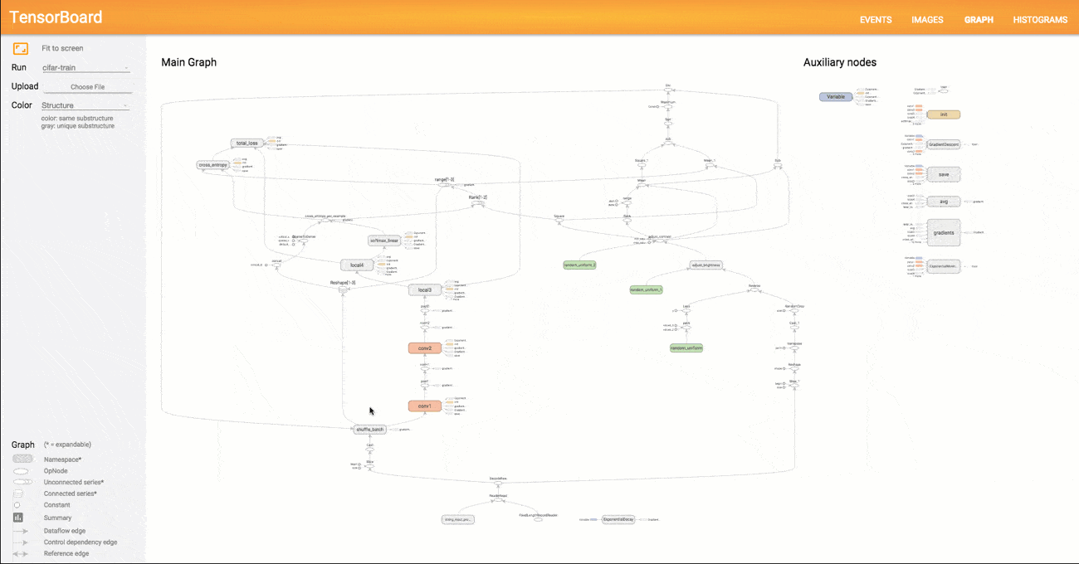
What isTensorFlow?
Conceptually based on Data Flow Graphs containing the following computation units:
Nodes = Mathematical Operations
Edges = n-dim Arrays (Tensors)
Some higher-level APIs (i.e. abstraction layers) are avaliable further simplifying the use of TF Examples: Tflearn, Keras, TF-Slim, among others
Notes:
Trainer Notes
Further details on TensorBoard can be found here: https://www.tensorflow.org/get_started/graph_viz
During research, the use of the above mentioned abstraction layers can be beneficial. Whereas, such tools typically come at the price of reduced functionality and require specific licensing. Therefore, they are generally not recommended for product development-related use

Slide 71
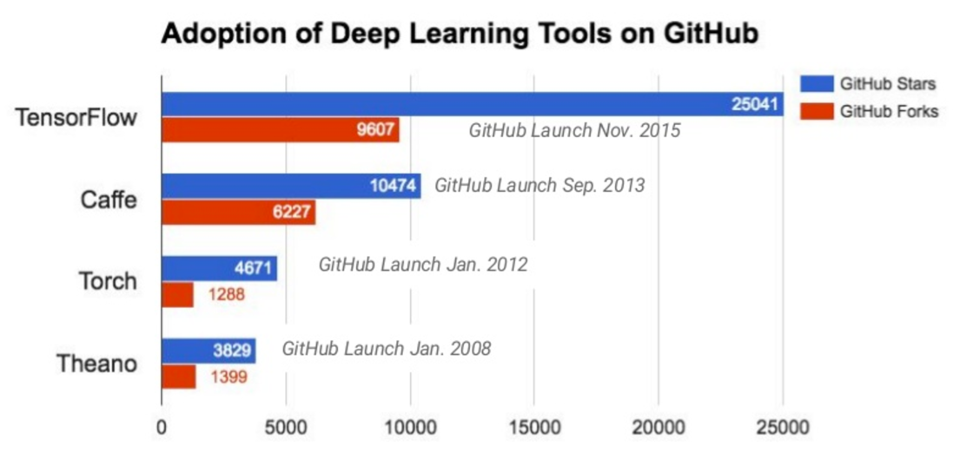
TensorFlow
Source: http://donnemartin.com/viz/pages/2015 // Jeff Dean, Large Scale Deep Learning with TensorFlow, Spark Summit 2016

Slide 72
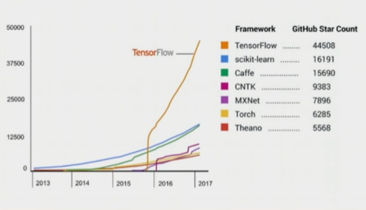
Growth rates based on GitHub star count

Slide 73
Why use TensorFlow?
Wide adoption
Extremely versatile library
Covers both ML research and productive use of ML
Provides Python, Java, C++, and Go APIs Python API is the most complete and easiest to use
Good performance due to C/C++ backend (soon: XLA – Accelerated Linear Algebra)
Supports CPUs, GPUs and distributed (cluster-based) processing
Integration with SAP Leonardo ML is planned
TensorFlow Serving (TF‘s model server) can be accessed from within HANA 2.0
Notes:
Trainer Notes
As with SAP Leonardo we embrace open standards, data scientists will be able to apply frameworks such as TensorFlow to develop their models
Please outline the integration of TensorFlow with SAP Leonardo once relevant information has become available
You may want to share the following video provided by Google introducing Tensorflow: https://youtu.be/mWl45NkFBOc

Slide 74
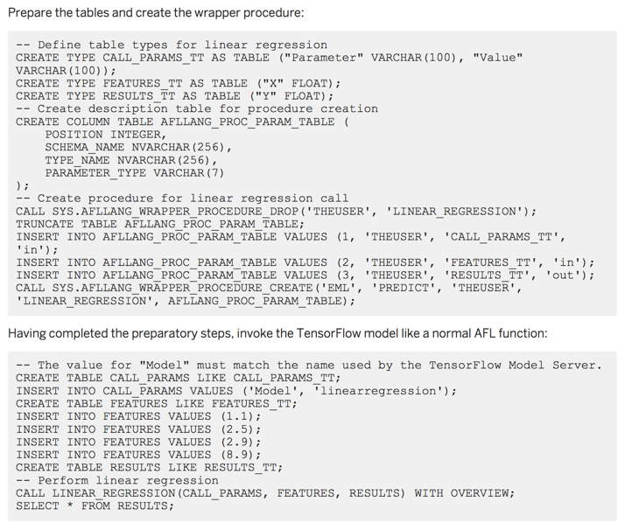
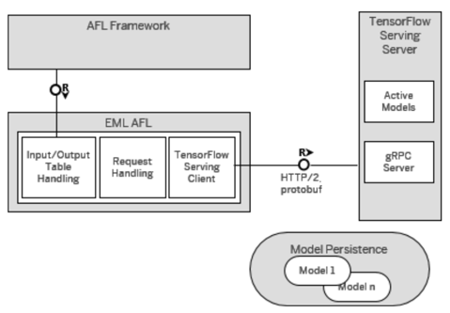
SAP HANA 2.0 – TensorFlow Serving Integration

Slide 75
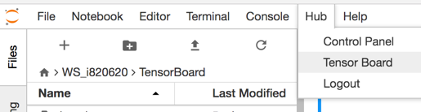
Nice Features
Automatic calculation of gradients (autodiff / GradientDescentOptimizer)
Parallel Processing
TensorFlow Serving
Both low-level and high-level functionality
TensorBoard

Slide 76
Spark Integration
Spark-Tensorflow-Connector
SparkDF.write.format("tfrecords").option("recordType", "Example").save("youtube-8m-video.tfrecord")
val newSparkDF: DataFrame =
spark.read.format("tfrecords").option("recordType", "Example").schema(videoSchema).load("youtube-8m-video.tfrecord")
(https://github.com/tensorflow/ecosystem/tree/master/spark/spark-tensorflow-connector)
Databricks: TensorFrames https://github.com/databricks/tensorframes
https://databricks.com/blog/2016/01/25/deep-learning-with-apache-spark-and-tensorflow.html
Yahoo: TensorFlowOnSpark https://github.com/yahoo/TensorFlowOnSpark

Slide 77
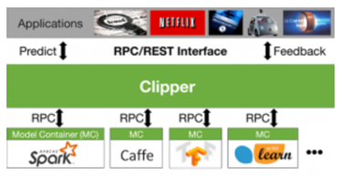
Outlook
Most Important topics within SAP should include:
State-of-the-art model server for Hana, ABAP and SCP
(Similar to Clipper?)
Transfer Learning (w/ customer scenarios)
Recurrent Neural Networks / (Long Short-Term Memory (LSTM)
Time series analysis with variable periodicity

Slide 78
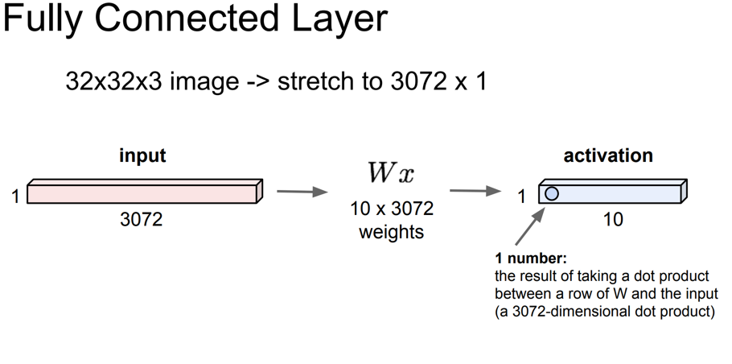
Convolutional Neural Networks (Contents: CS231n)

Slide 79
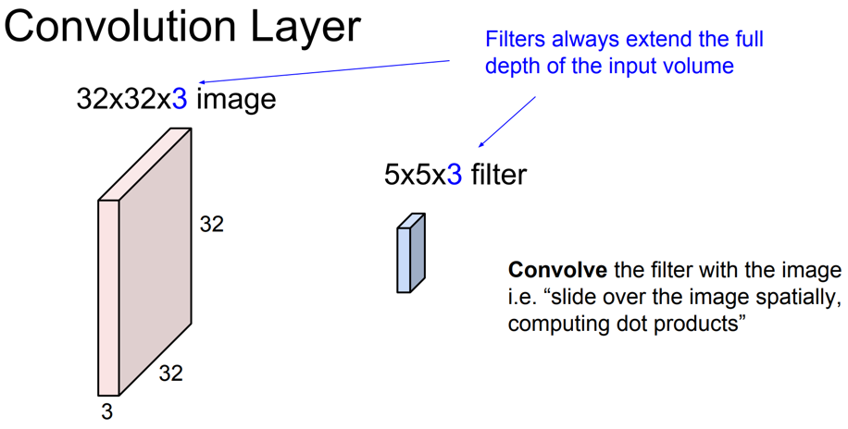
Convolutional Neural Networks

Slide 80
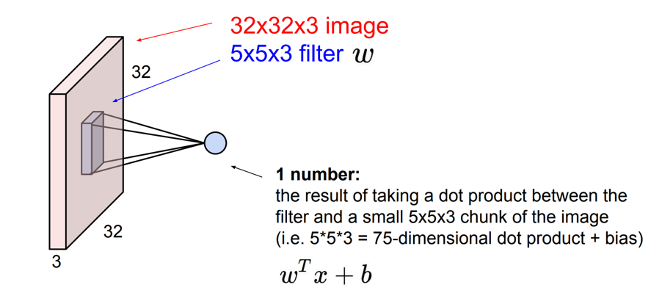
Convolutional Neural Networks

Slide 81
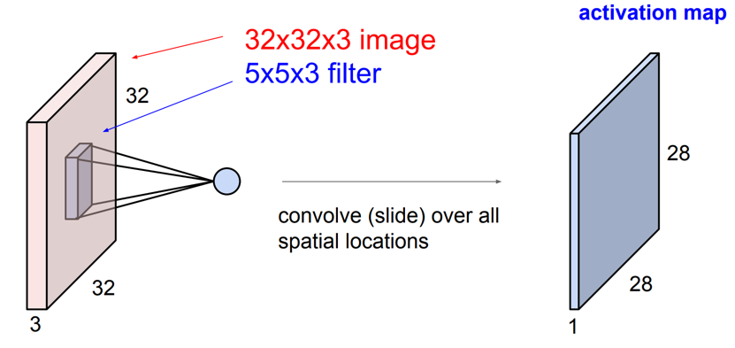
Convolutional Neural Networks

Slide 82
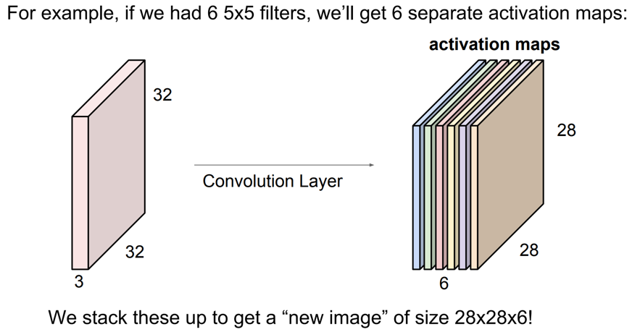
Convolutional Neural Networks

Slide 83
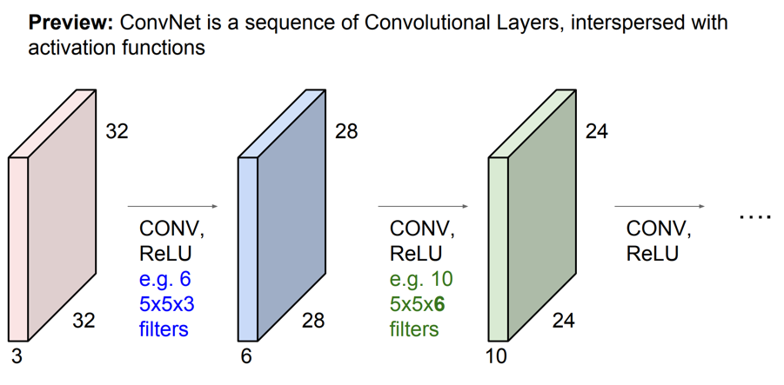
Convolutional Neural Networks

Slide 84
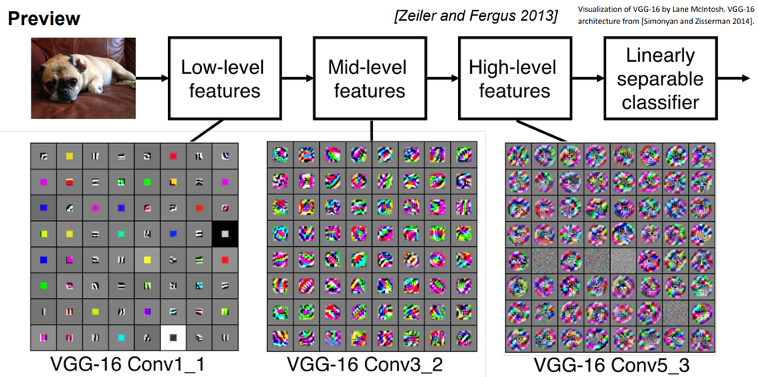
Convolutional Neural Networks

Slide 85
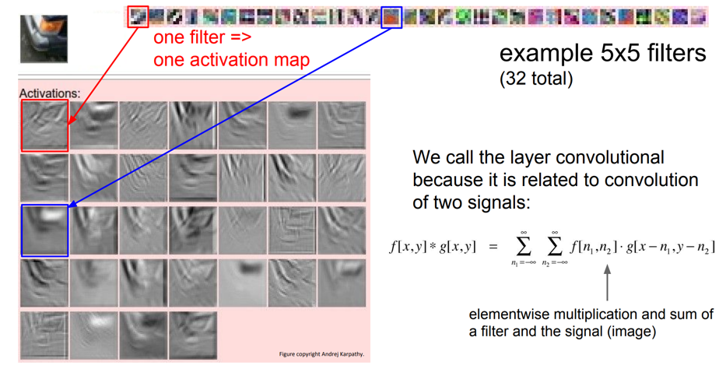
Convolutional Neural Networks

Slide 86
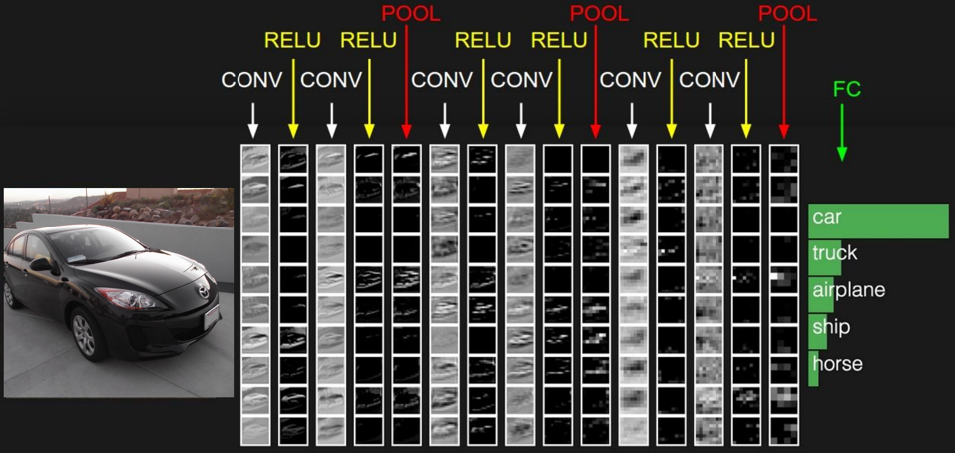
Convolutional Neural Networks

Slide 87
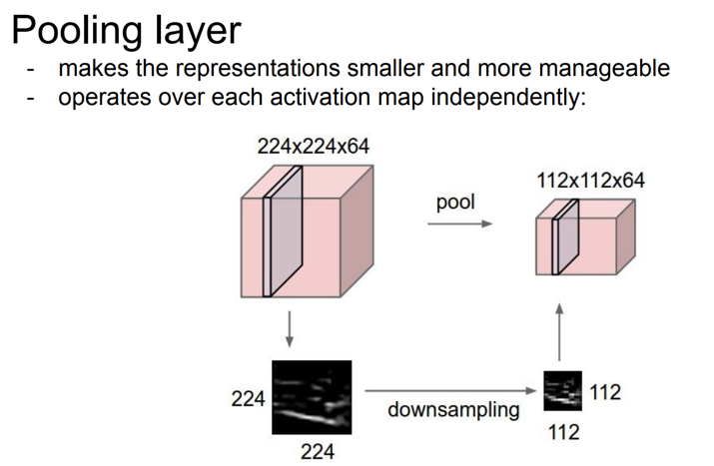
Convolutional Neural Networks

Slide 88
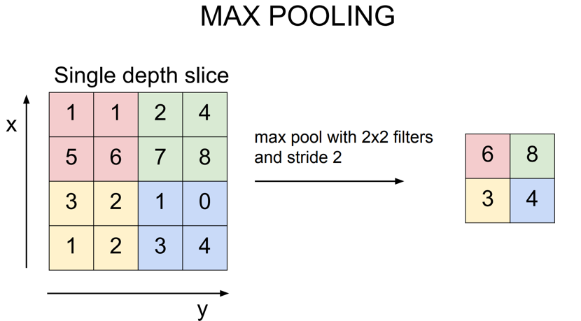
Convolutional Neural Networks

Slide 89
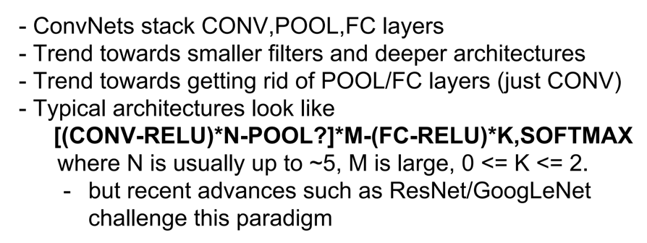
Convolutional Neural Networks

Slide 90
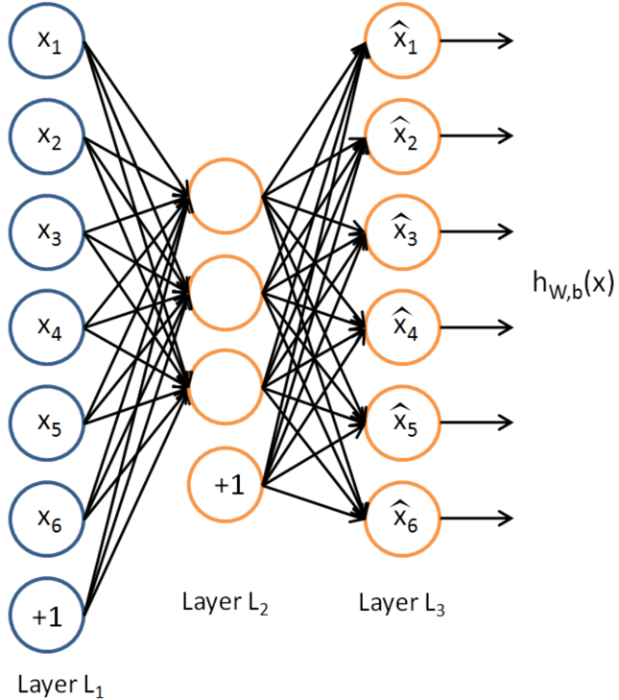
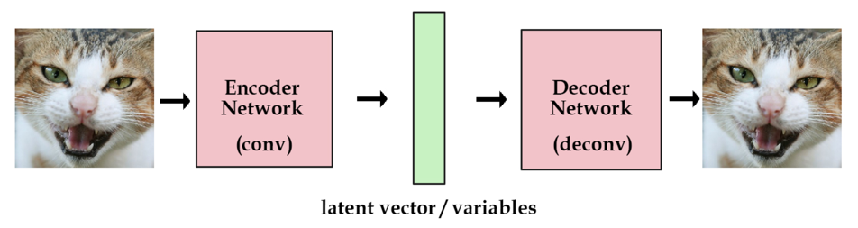
Autoencoders

Slide 91
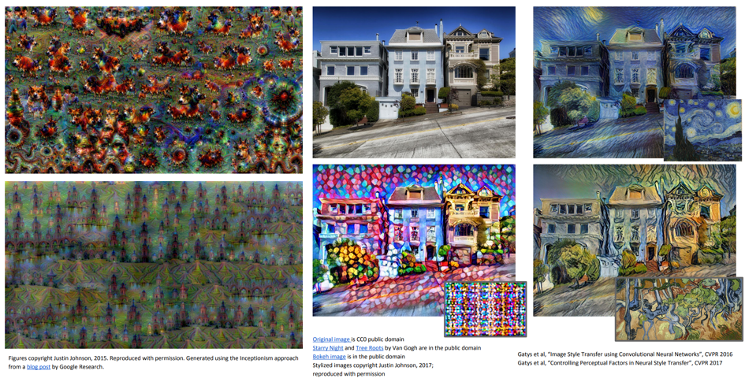
Deep Dream
http://www.datascienceassn.org/content/tensorflow-tutorial-deepdream-algorithm

Slide 92
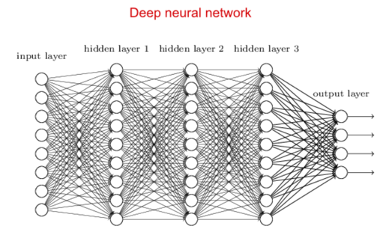
Recurrent Neural Networks

Slide 93
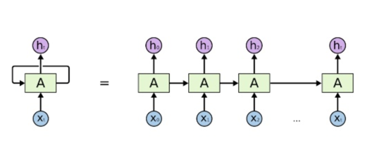
Recurrent Neural Networks

Slide 94
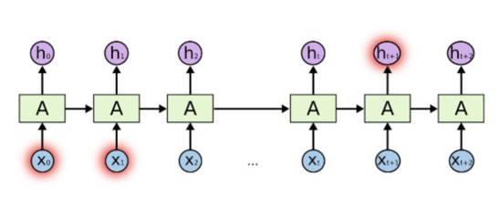
Recurrent Neural Networks

Slide 95

Recurrent Neural Networks - LSTMs

Slide 96
Recurrent Neural Networks / LSTMs
http://colah.github.io/posts/2015-08-Understanding-LSTMs/

